Slide 1



NEW YORK PARKING TICKETS THE YEARLY ANALYSIS
GROUP #3:
Aakanksha Tasgaonkar
Amogh Mahesh
Rupa Mahendran
Sriganesh Baskaran

Slide 2

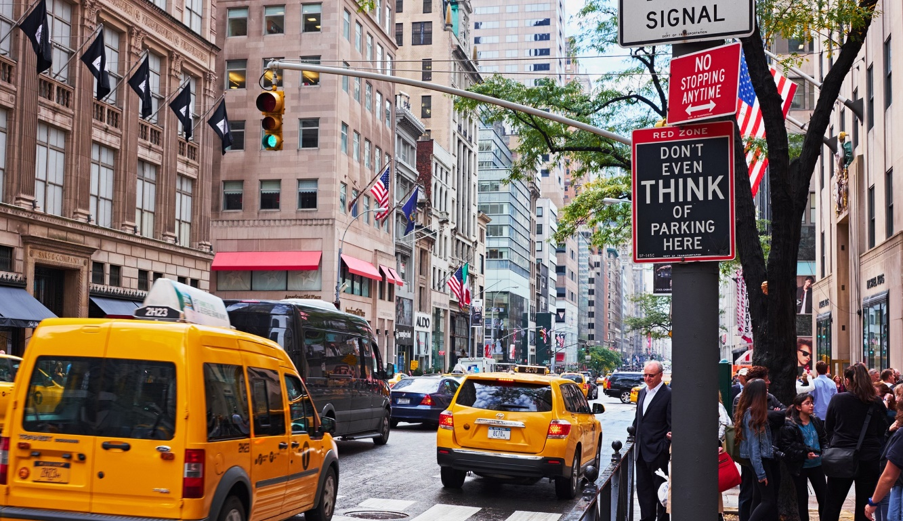
INTRODUCTION
Dataset size: 8GB
Queries to filter and categorize top important information.
URL: https://www.kaggle.com/new-york-city/nyc-parking-tickets

Slide 3

OBJECTIVES
Learn how to use HiveQL, Power BI ,Tableau and Excel 3D maps.
Filter out the statistical data of the violation rate and visualize the same.
Comparison between the visualizations on various aspects.

Slide 4
SPECIFICATION
Dataset size: 8GB
Cluster version: Oracle Cloud 4.2
No of nodes: 5
Memory size: 32GB
CPU Speed: 2.2GHz
https://www.kaggle.com/new-york-city/nyc-parking-tickets

Slide 5
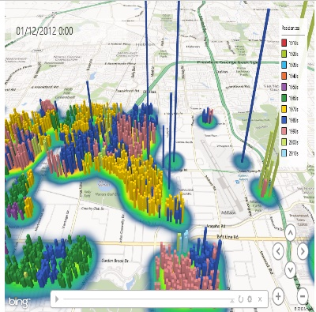




DATA PROCESSING
NYC Parking Tickets Data
EXCEL 3D MAP
POWER BI
TABLEAU

Slide 6
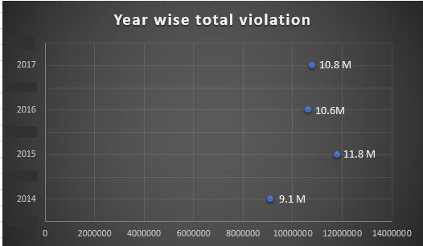
NEW YORK CITY
Overall number of violations occurred in 4 consecutive years.
Maximum Violation-2015
Minimum Violation-2014

Slide 7

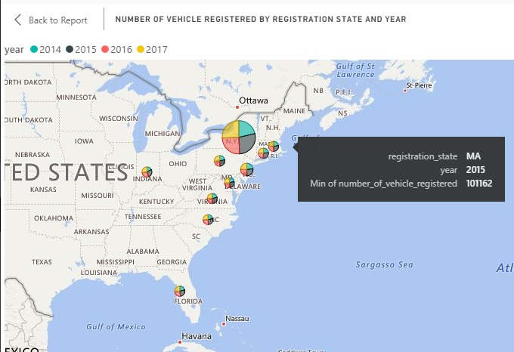

NUMBER OF VEHICLES REGISTERED-STATE AND YEAR
Number of violations made in New York City by vehicles registered from different states.
Maximum vehicle registrations - 2015

Slide 8



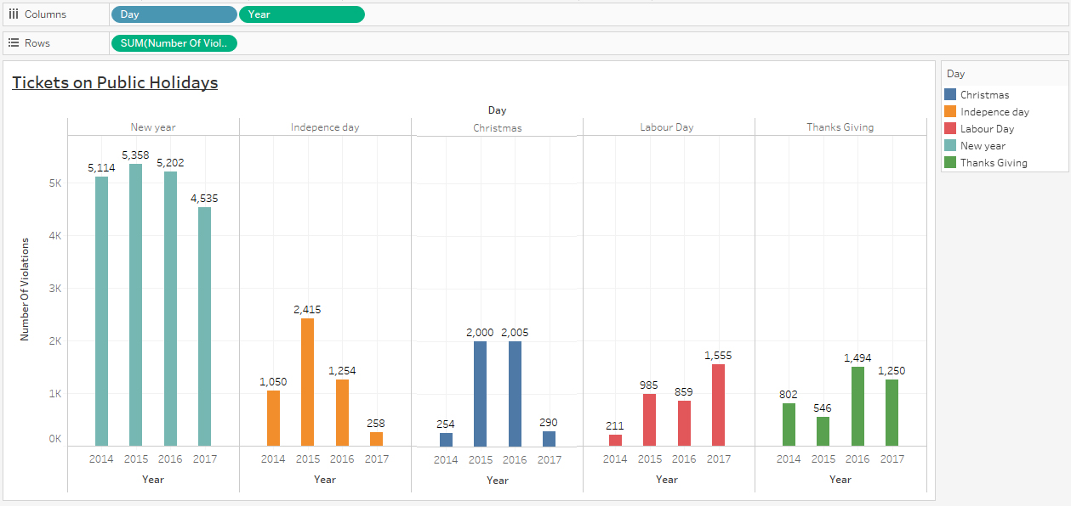
NUMBER OF VIOLATIONS-PUBLIC HOLIDAYS
Maximum number of violations-New Year
Double the count on the New Year as compared to the Independence Day.

Slide 9


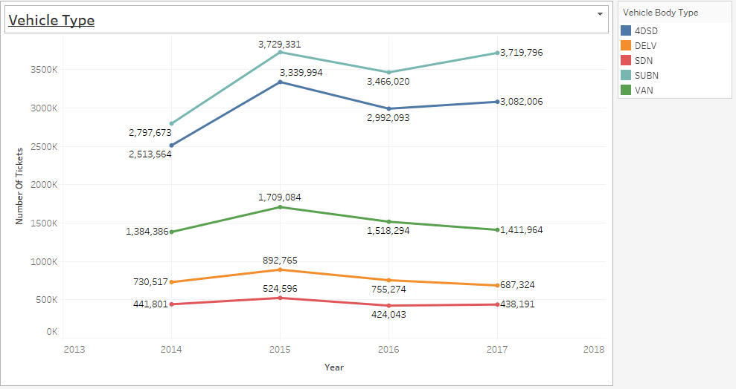
NUMBER OF VIOLATIONS-VEHICLE BODY TYPE
Minute change in the number of tickets between the consecutive years for the sedan vehicles.
Drastic difference in the number of tickets during 2014-2015 caused by the suburban vehicles.

Slide 10
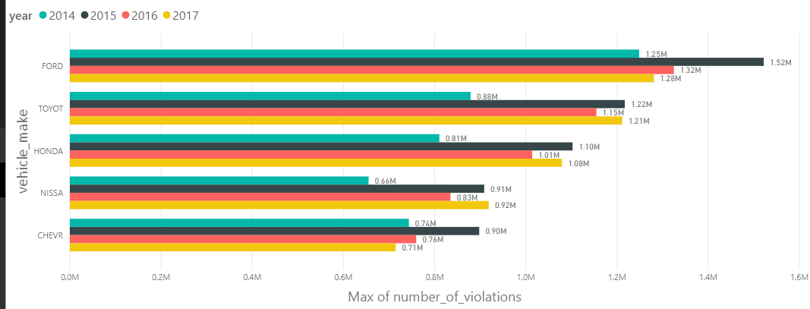
Number of Violation – Vehicle Make
FORD users – highest violations in year 2015
NISSAN users – lowest violations in year 2014
CHEVROLET users – lowest violations in year 2017

Slide 11

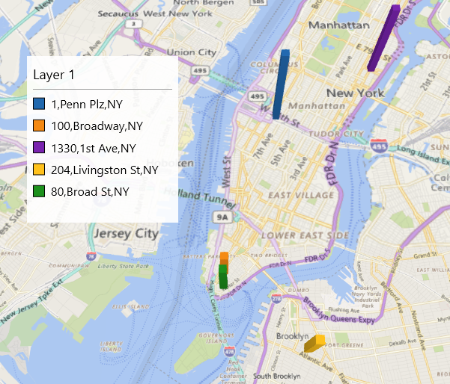
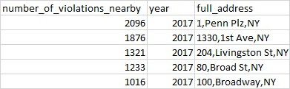
NUMBER OF VIOLATIONS–STREET-WISE ANALYSIS
1, Penn Plz, NY - most violated street in the year 2017

Slide 12


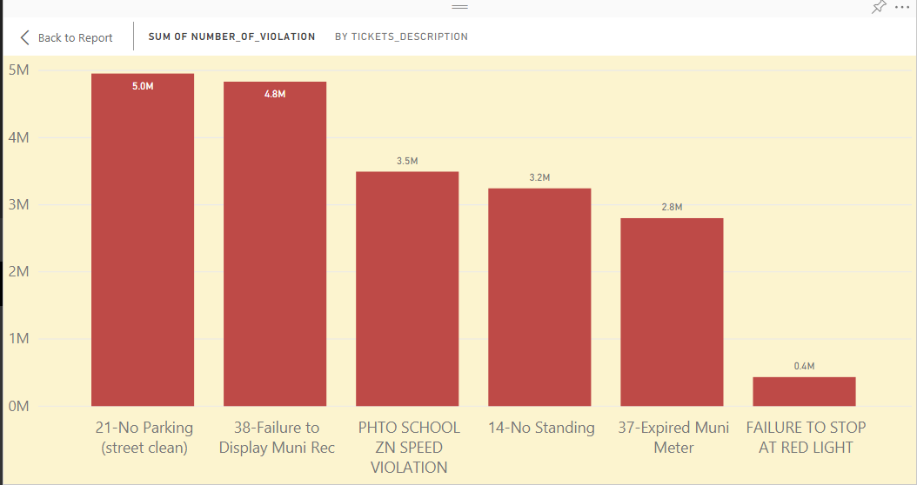
NUMBER OF VIOLATIONS-CATEGORIES OF TICKETS
Number of violations for different categories of tickets.
Highest - no parking street
Lowest - failure to stop at red light

Slide 13

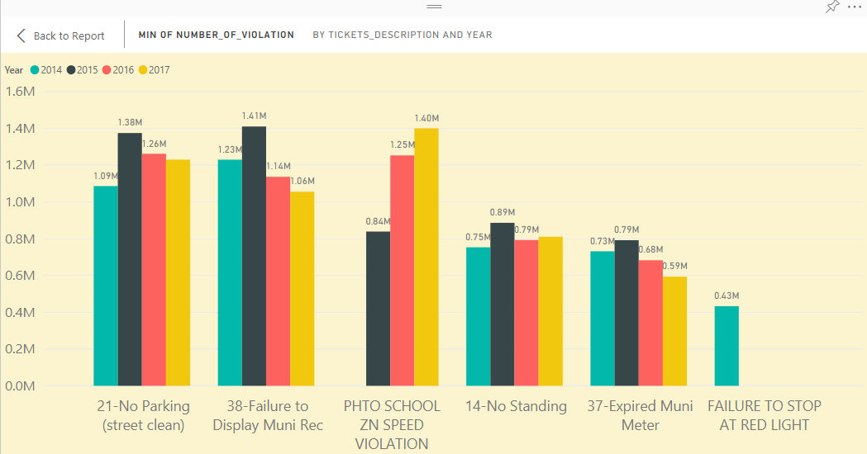
TYPES OF VIOLATIONS–YEARLY ANALYSIS
Based on the type of violations categorized with respect to years.
Failure to stop at red light –only in year 2014
Phto school zn speed violation doubled -2017 as compared to 2015

Slide 14


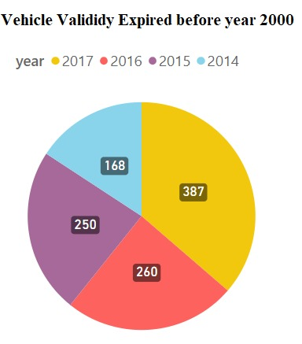
VIOLATION BY EXPIRED VEHICLES –YEARLY ANALYSIS
Vehicles expired before the year 2000.
Greater number of expired vehicles -2017.
Least number of expired vehicles -2014.

Slide 15





SUMMARY
Successfully used many tools learned in class such as HiveQL, Oracle Cloud, Power BI and Tableau to use and visualize data.
The parking violation has been gradually reduced as compared to previous years.
The suburban vehicles has been marked high for its parking violations.
Highest number of violation type - “No Parking Street”

Slide 16

REFERENCES
https://www.kaggle.com/new-york-city/nyc-parking-tickets
https://github.com/amoghmahesh/hiveanalysisonnycparkingticket
https://www.kaggle.com/new-york-city/nyc-parking-tickets
http://www.nyc.gov/html/dof/html/pdf/faq/stars_codes.pdf
https://www.kaggle.com/donyoe/exploring-42-3m-nyc-parking-tickets/notebook
https://www1.nyc.gov/site/finance/vehicles/services-violation-codes.page

Slide 17


THANK YOU!

